Slide 1
SUSTech HPC Monitor System Development
Liquan Wang, Zi’an Wang, Shuxin Li
Advisor: Zhuozhao Li

Slide 2
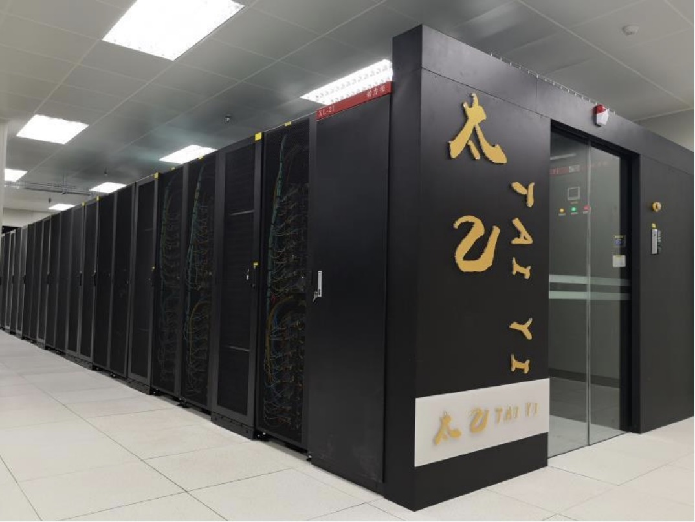
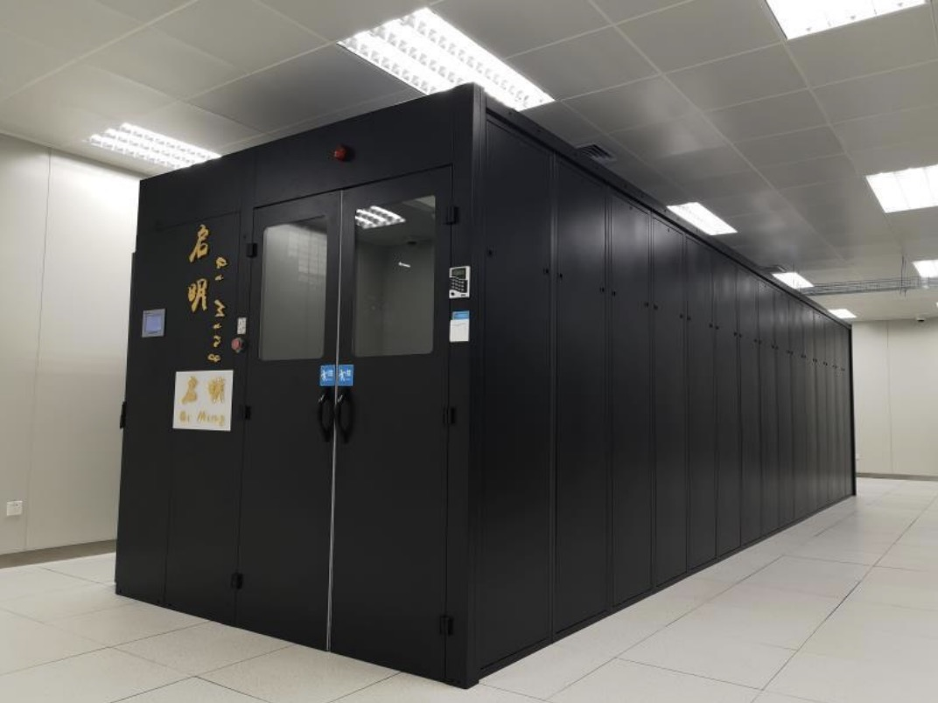
The Center for Computational Science and Engineering
In charge of two clusters, Taiyi and Qiming, with over 1000 servers
Serving over 100 research groups of SUSTech
Provided over 140 million core hours of service

Slide 3
System Requirements
Customizable monitoring of specific hardware and software types
Manual addition of system failures after human inspection with issue track
Customizable data display charts
Support for custom configuration of alarm rules and thresholds
User management support

Slide 4
Frontend
Technology stack
Vue + VueRouter + Pinia + Vite
Axios
ES6
Element-plus
Project Structure
├─node_modules
├─public
└─src
├─api
├─assets
├─components
├─router
├─stores
│ └─modules
├─utils
└─views
├─article
│ └─components
├─layout
├─login
└─user

Slide 5
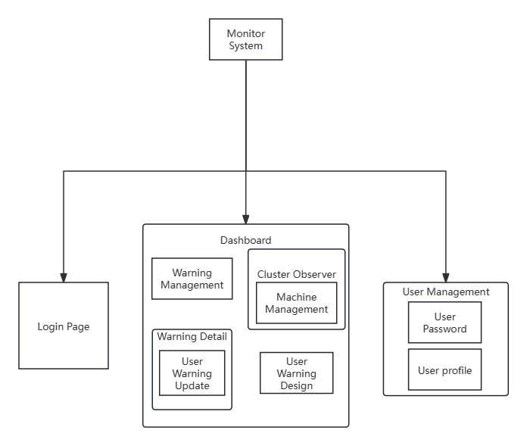
Frontend
Functional modules

Slide 6
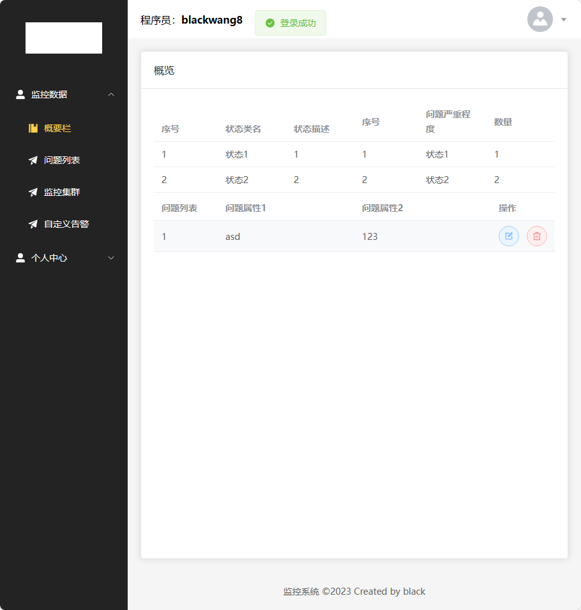
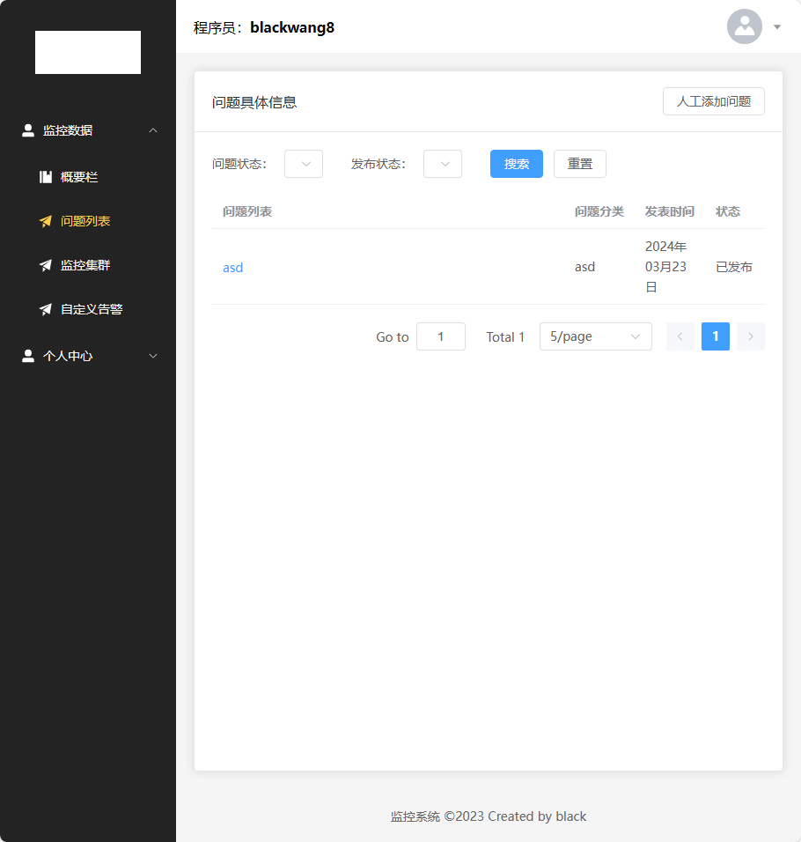
Static Page Design

Slide 7
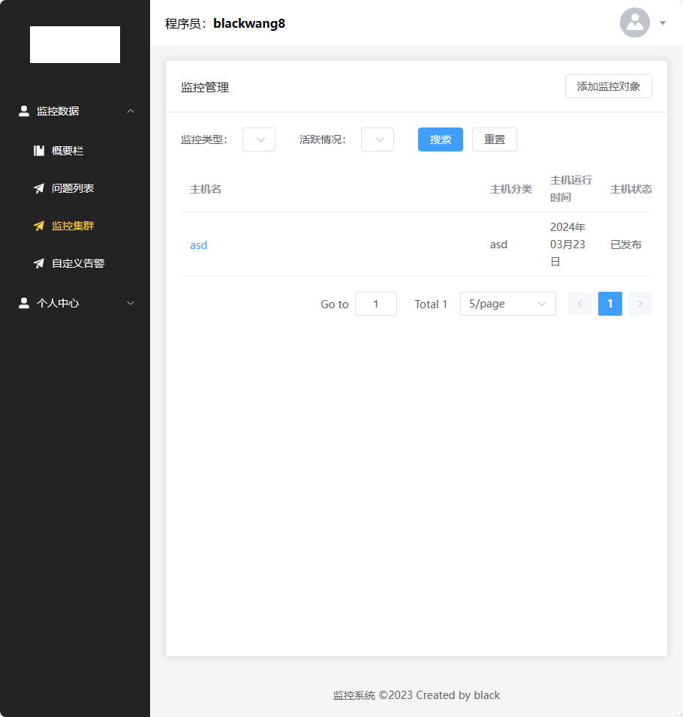
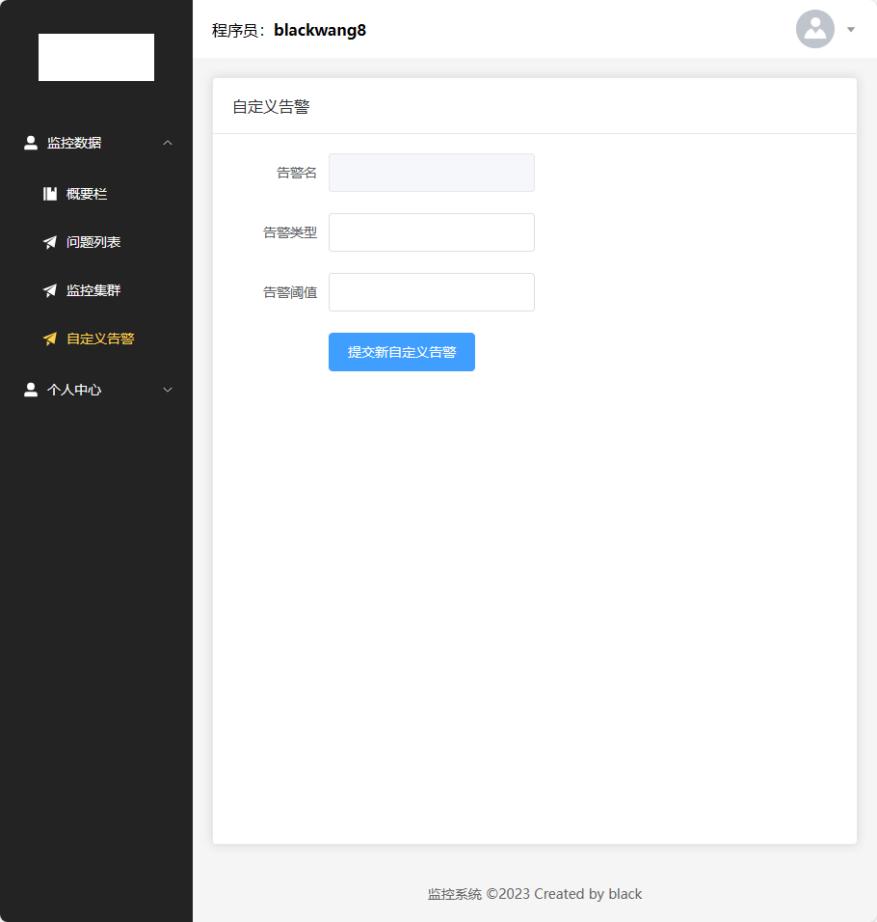
Static Page Design

Slide 8
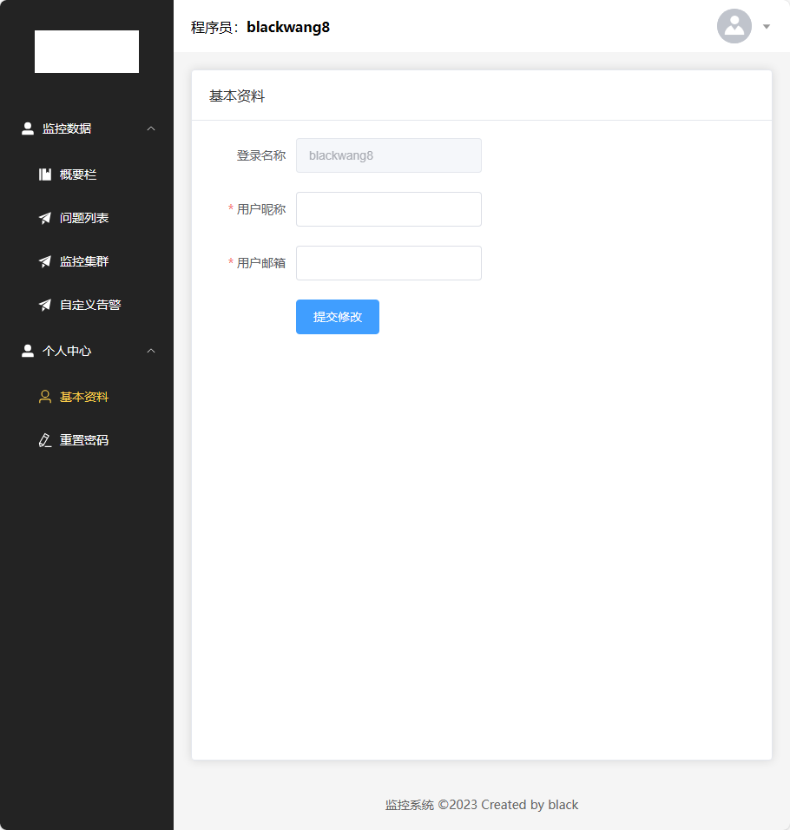

Static Page Design

Slide 9
Store and Backend coordinate
User store has been created by Pinia to store the related data about user, in order to meet the other needs in next stage of project development.
Axios has been wrapped request.js and has begun integrating with the existing backend interfaces. Currently, all the developed interfaces have been debugged, are operational, and are able to receive data from the backend.

Slide 10
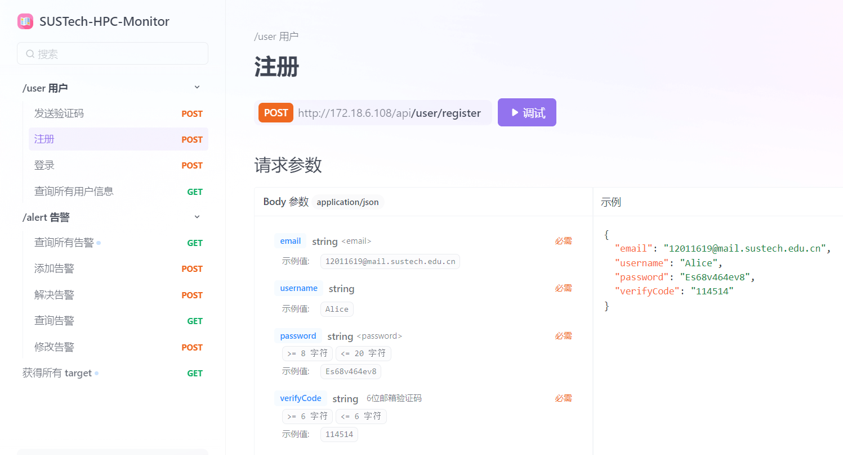

API Management
Detailed API documentation can help the interaction between frontend and backend. We use Apifox to manage HTTP API, which is a professional API management platform
ApiFox

Slide 11
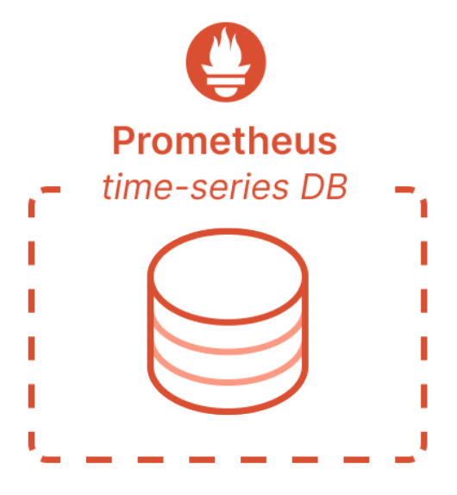


Database Management
We use database for supplement information management.
Target Hierarchy Management
User Management
….
+

Slide 12
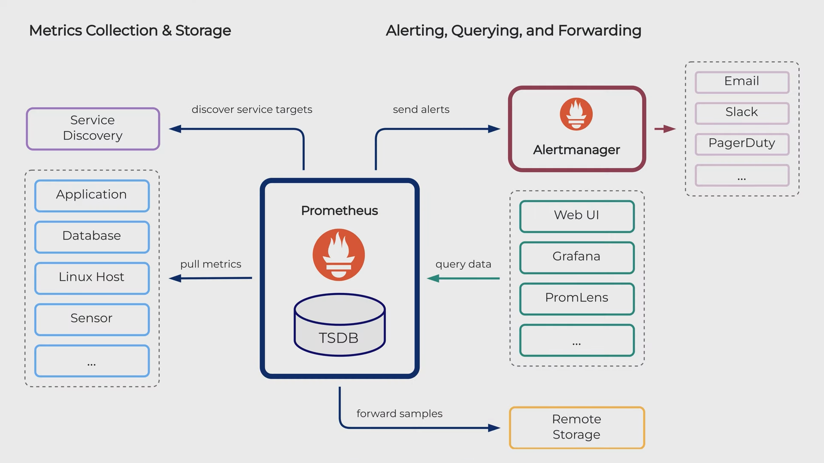
Prometheus
Prometheus is an event monitoring platform which integrates an embedded time-series database.
The monitoring server scrapes the metrics exposed through an endpoint from the targets.
Prometheus architecture
Notes:
The monitoring system does not consider the peak period, which is continuous and periodic. The larger the number of machines and the increase of data will make the writing of the database become a certain bottleneck. The maximum number of single machines given by the official website is 5000, so it is necessary to increase the proxy and increase the cost.

Slide 13
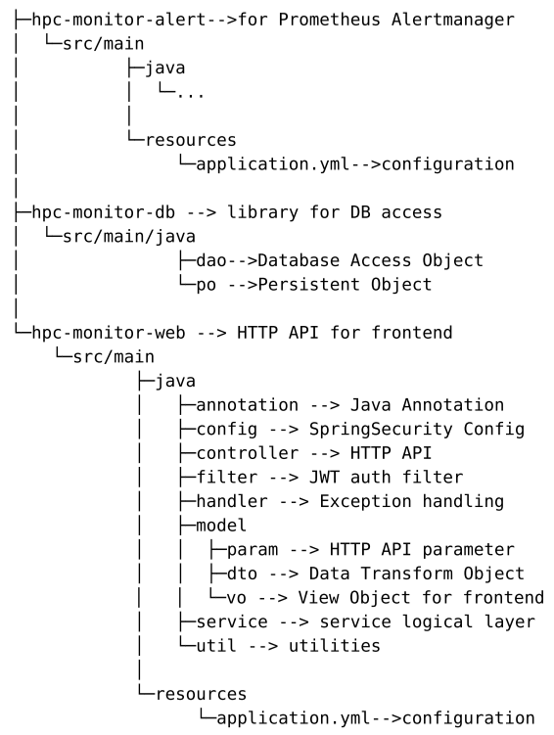
Backend project structure
Notes:
The monitoring system does not consider the peak period, which is continuous and periodic. The larger the number of machines and the increase of data will make the writing of the database become a certain bottleneck. The maximum number of single machines given by the official website is 5000, so it is necessary to increase the proxy and increase the cost.

Slide 14
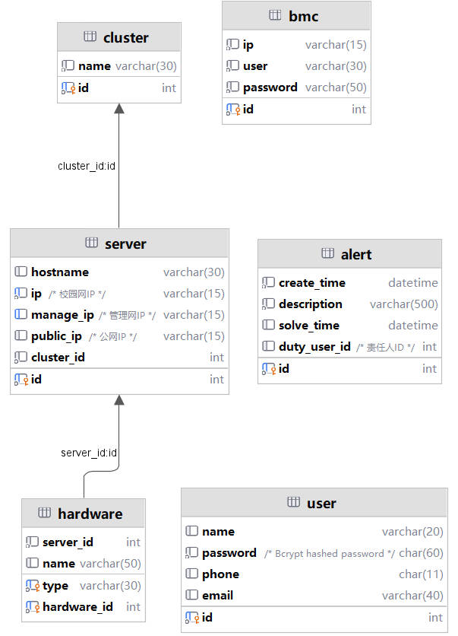
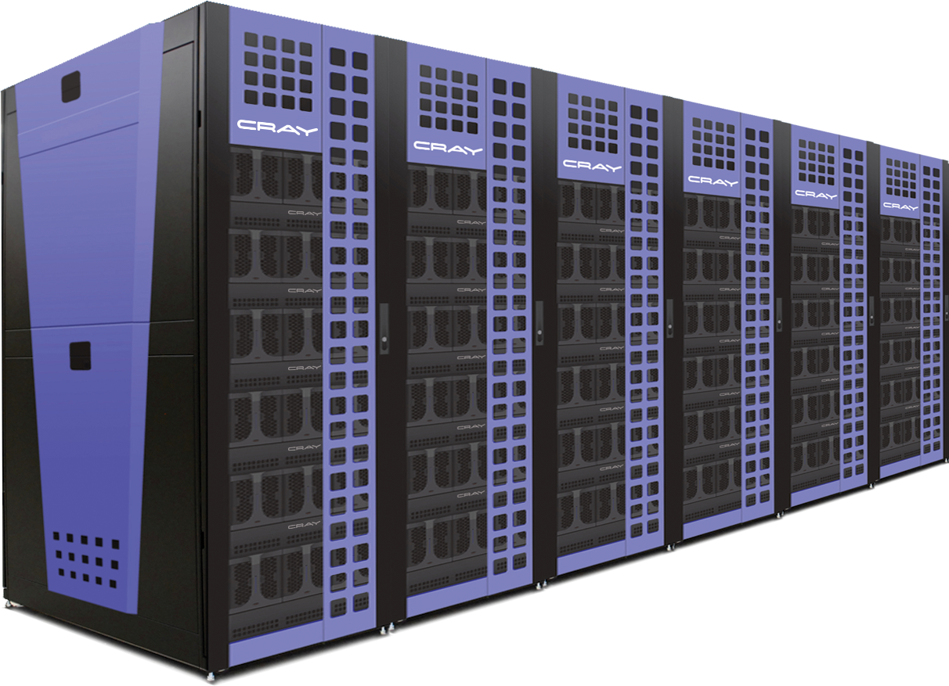
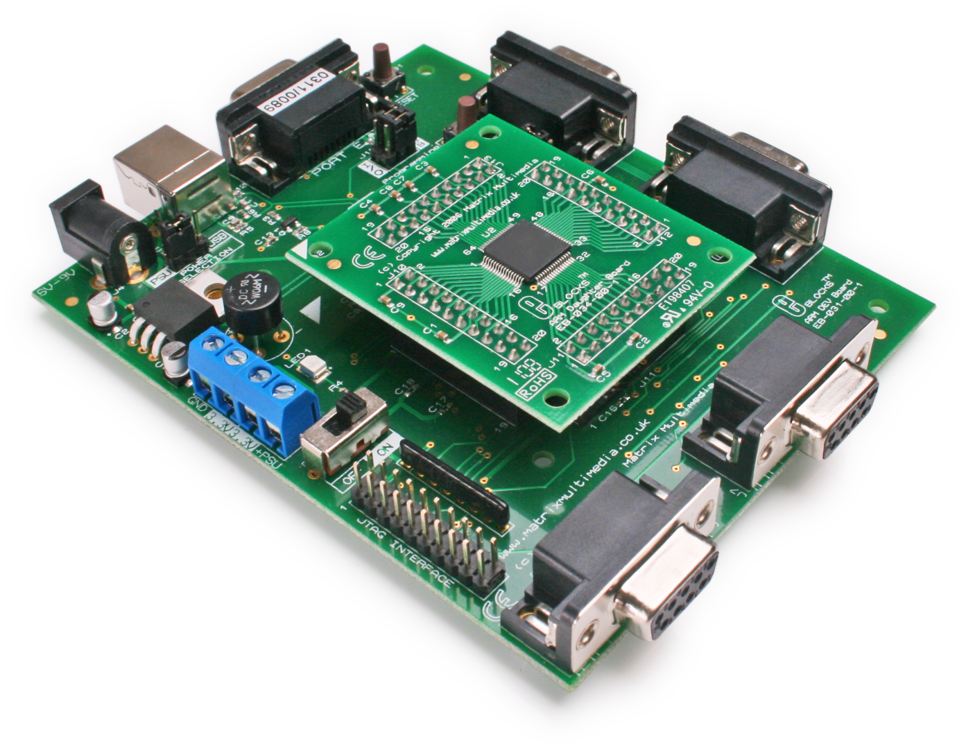

Database Management
Cluster
Taiyi
Hardware - BMC
11.11.3.101
LAN_2_0
ADMIN
ADMIN
Host
Intel Server 1
172.18.6.108

Slide 15
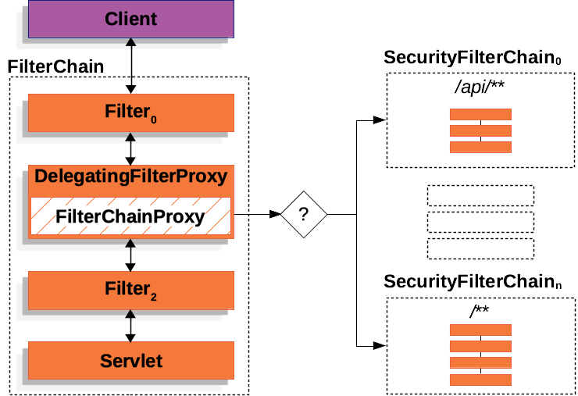
JWT Authentication
Insert custom JWT filter into SpringSecurity framework’s native filter chains

Slide 16
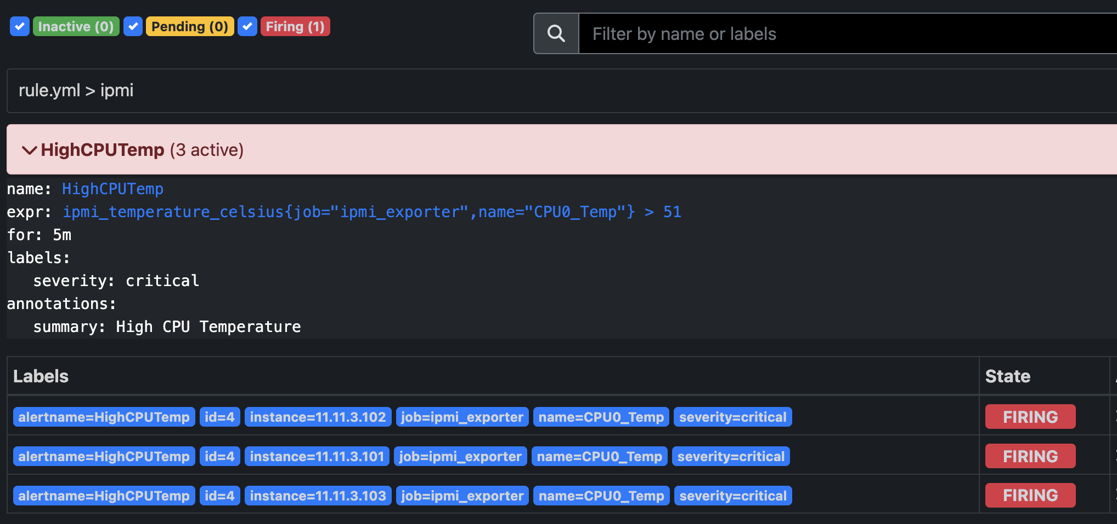
Alert Management
Prometheus: Set up customized alert rules through yaml files using the PromQL language.
rule.yml:
expression
observation time
critical level
Backend system: Control rule file for each monitor job (Write user configuration into required yaml format) and link files to Prometheus.

Slide 17
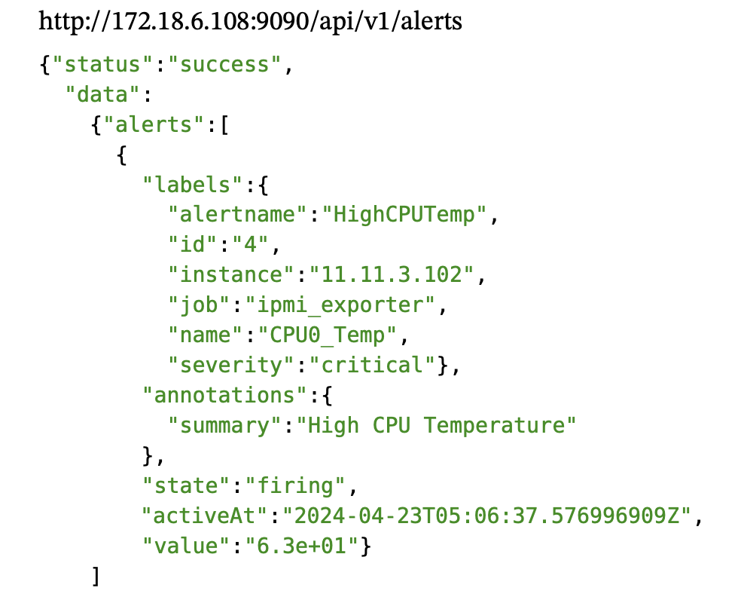
Alert Management
Retrieve the alerts' information through the http api Prometheus provides
Extract information of interest for front-end display.

Slide 18
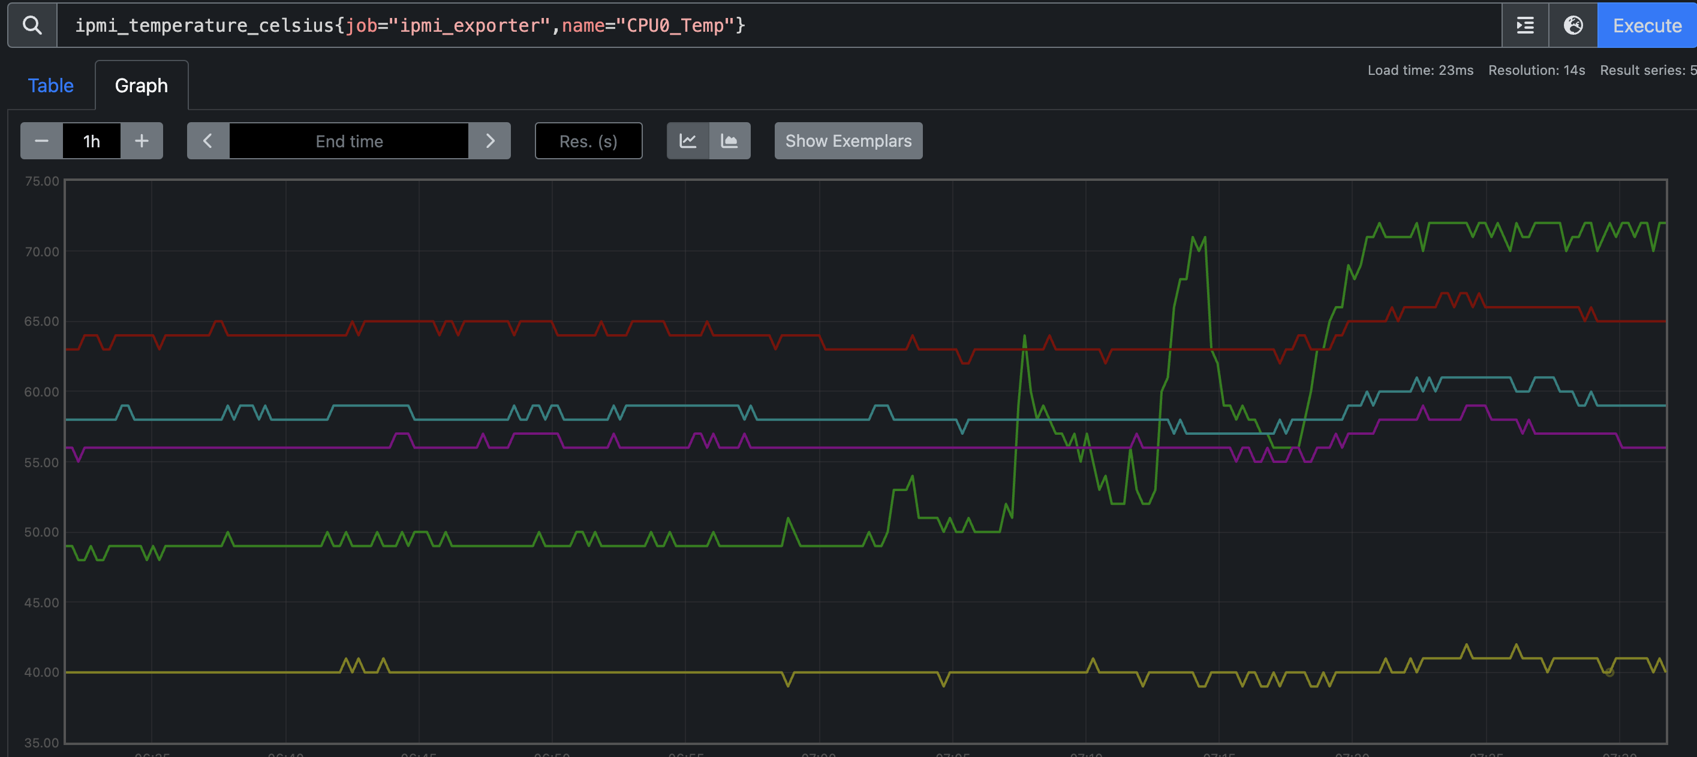
BMC Monitoring
BMC data: CPU temperature, fan speed, voltage state, etc
Plot of cpu0 temperature in celsius degree for 5 hosts

Slide 19
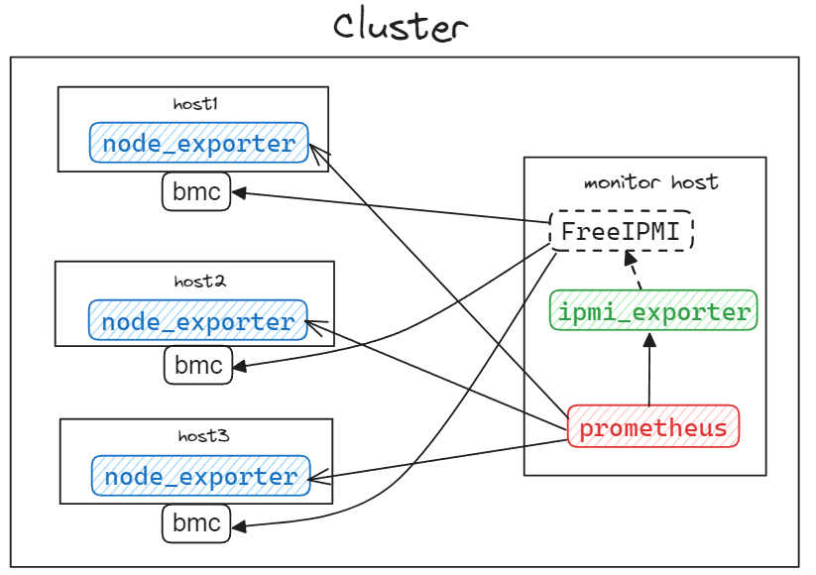
BMC Monitoring
Exporter: Github open-source ipmi exporter
*https://github.com/prometheus-community/ipmi_exporter

Slide 20
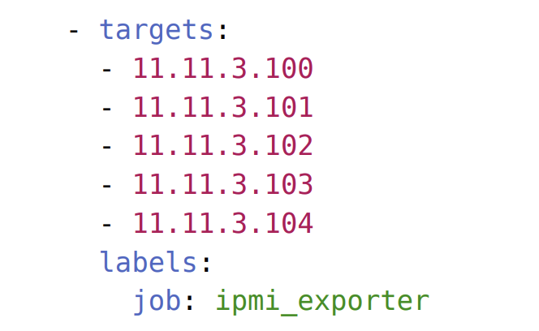
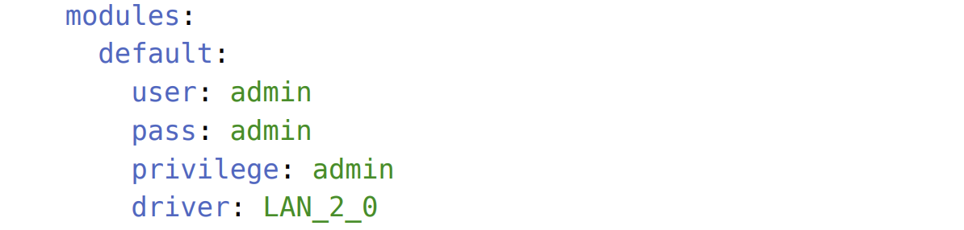
BMC Monitoring
Target Config:
The ipmi exporter uses an yaml file on the Prometheus server side for target specification.
Target configurations are done on the exporter side.
Our back-end is responsible for managing both side yaml files according to user-provided information.
target.yml
ipmi_exporter.yml

Slide 21
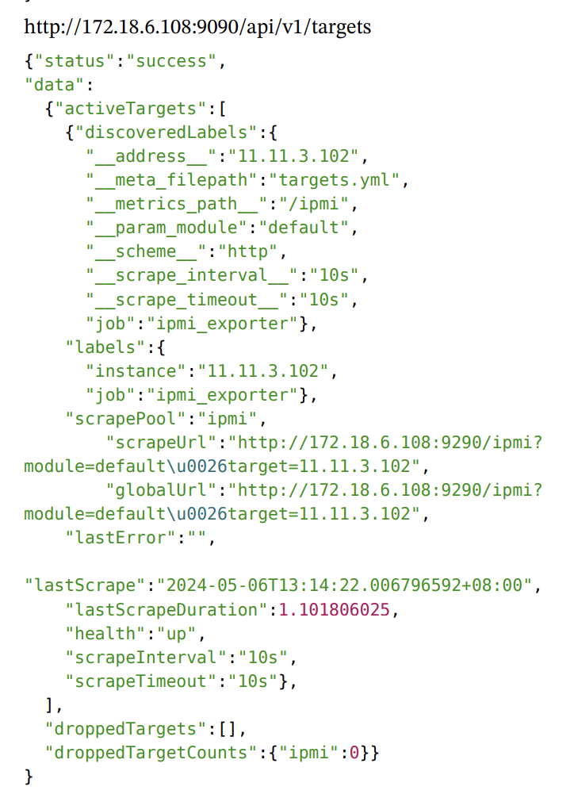
BMC Monitoring
Retrieve the targets' information through the http api Prometheus provides
Extract information of interest for front-end display.

Slide 22
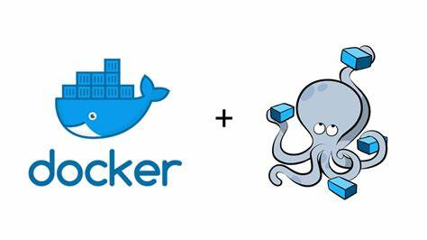
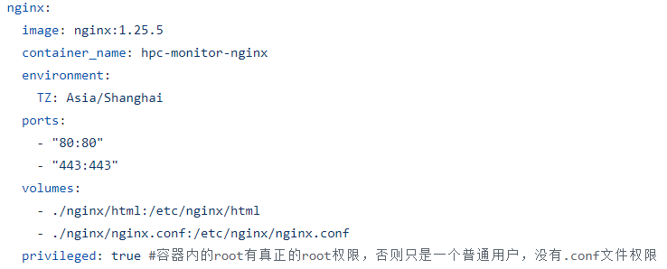
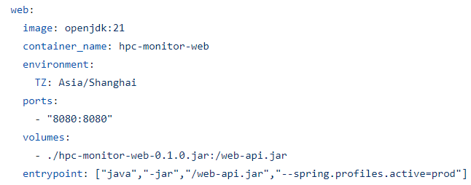
Containerized Deployment
docker compose
JDK21 container for backend
Nginx container for frontend

Slide 23
Thank you!

